Slide 1





TO ENSURE THE SMOOTHNESS OF TODAY'S DISCUSSION, LET'S OBSERVE THE FOLLOWING
HOUSE RULES

Slide 2

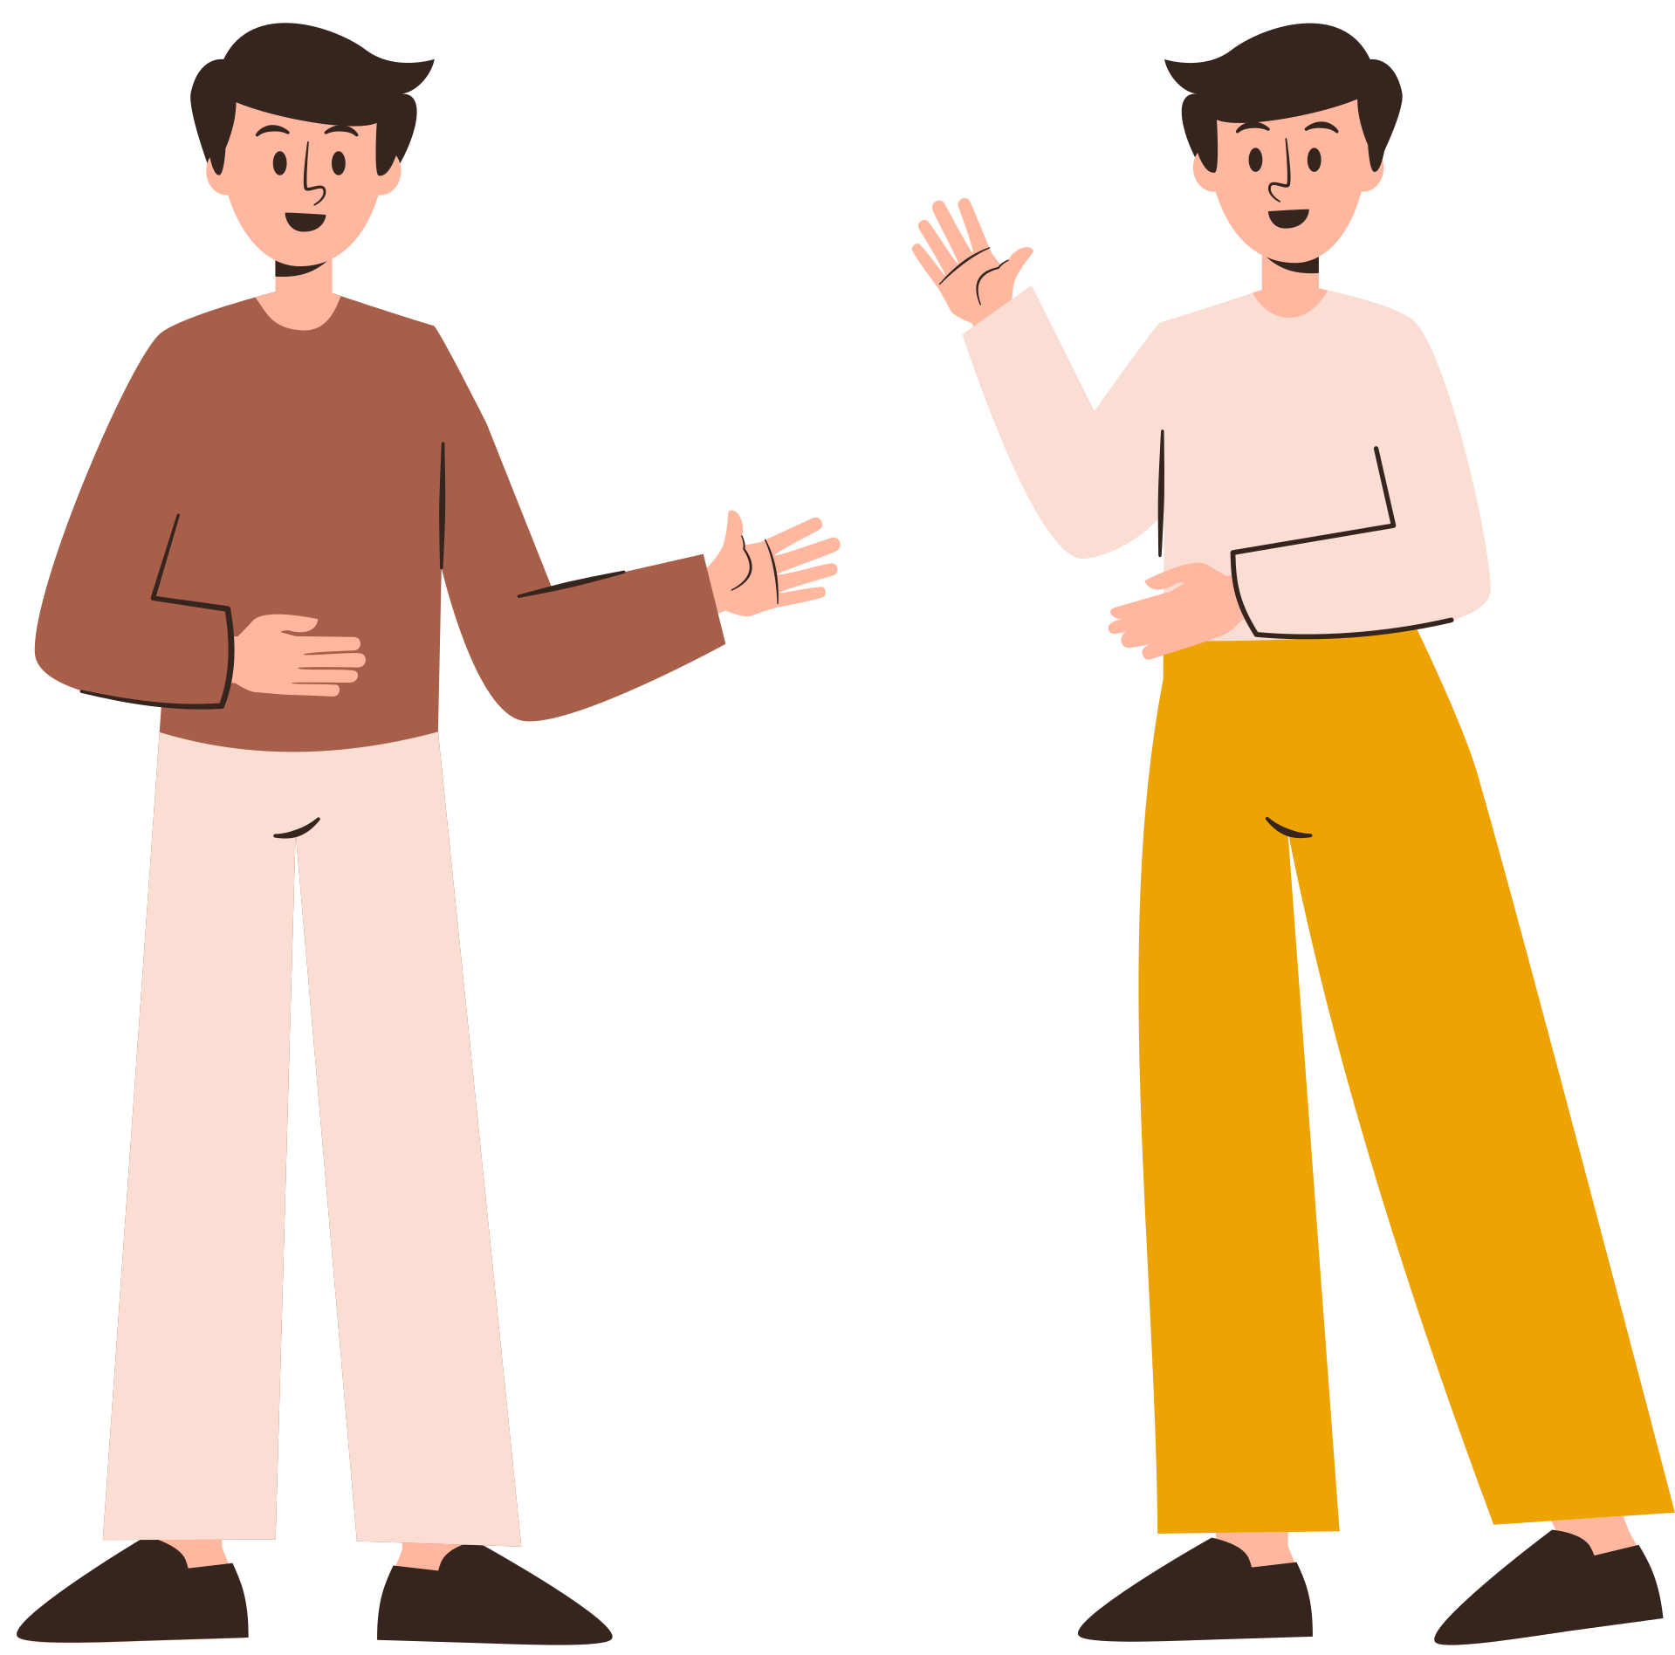


PARTICIPATE AND ALWAYS
SMILE

Slide 3

CHATTING IS RESERVED FOR QUESTIONING PURPOSES ONLY

Slide 4

CLEAN AS YOU GO

Slide 5

STAY FOCUSED

Slide 6





TURN OFF YOUR PHONES OR PUT IT ON SILENT MODE

Slide 7


SLEEPING IS STRICTLY PROHIBITED

Slide 8

GOD BLESS!
Ed

